Slide 1
Data Structures
Liad Cohen
Dana Shapira
Union Find

Slide 2
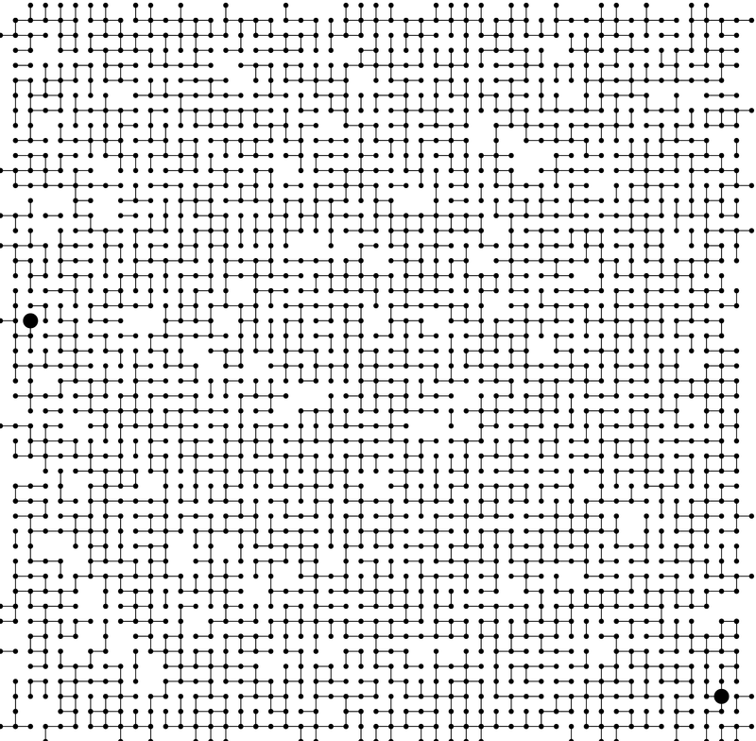
Motivation
Notes:
Kruskal's algorithm. ・Connected components.
medium.txt (625 sites, 900 edges, 3 connected components)

Slide 3
Connectivity
Find - Check if two objects are in the same component.
Union - Replace components containing two objects with their union.
0
1
2
3
4
5
6
7
{ 0 } { 1 4 5 } { 2 3 6 7 }
Notes:
Simple model captures the essential nature of connectivity.
equivalence relation partitions objects into equivalence classes
sets = connected components = equivalence class

Slide 4
Connectivity
Find - Check if two objects are in the same component.
Union - Replace components containing two objects with their union.
union(2, 5)
0
1
2
3
0
1
2
3
4
5
6
7
4
5
6
7
{ 0 } { 1 4 5 } { 2 3 6 7 }
{ 0 } { 1 2 3 4 5 6 7 }

Slide 5
Union/Find
Assumptions:
The Sets are disjoint.
Each set is identified by a representative of the set.
Initial state:
A union/find structure begins with n elements, each considered to be a one element set.
Functions:
Make-Set(x): Creates a new set with element x in it.
Union(x,y): Make one set out of the sets containing x and y.
Find-Set(x): Returns a pointer to the representative of the set containing x.

Slide 6
Basic Notation
The elements in the structure will be numbered from 0 to n-1
Each set will be referred to by the number of one of the element it contains
Initially we have sets S₀,S₁,…,S_{n-1}
If we were to call Union(S₂,S₄), these sets would be removed from the list, and the new set would now be called either S₂ or S₄
Notations:
n Make-Set operations
m total operations
n≤m

Slide 7
First Attempt
Represent the Union/Find structure as an array arr of n elements
arr[i] contains the set number of element i
Initially, arr[i]=i (Make-Set(i))
Find-Set(i) - returns the value of arr[i]
To perform Union(S_{i},S_{j}):
For every k such that arr[k]=j, set arr[k]=i

Slide 8
First Attempt
Integer array arr[] of size n.
Interpretation: i and j in same component iff they have the same set number.
0
1
2
3
4
5
6
7
8
9
0 | 1 | 2 | 3 | 4 | 5 | 6 | 7 | 8 | 9
0 | 1 | 9 | 9 | 9 | 6 | 6 | 7 | 8 | 9

Slide 9
Analysis
The worst-case analysis:
Find(i) takes O(1) time
Union(S_{i},S_{j}) takes Θ(n) time
A sequence of n Unions will take Θ(n²) time

Slide 10
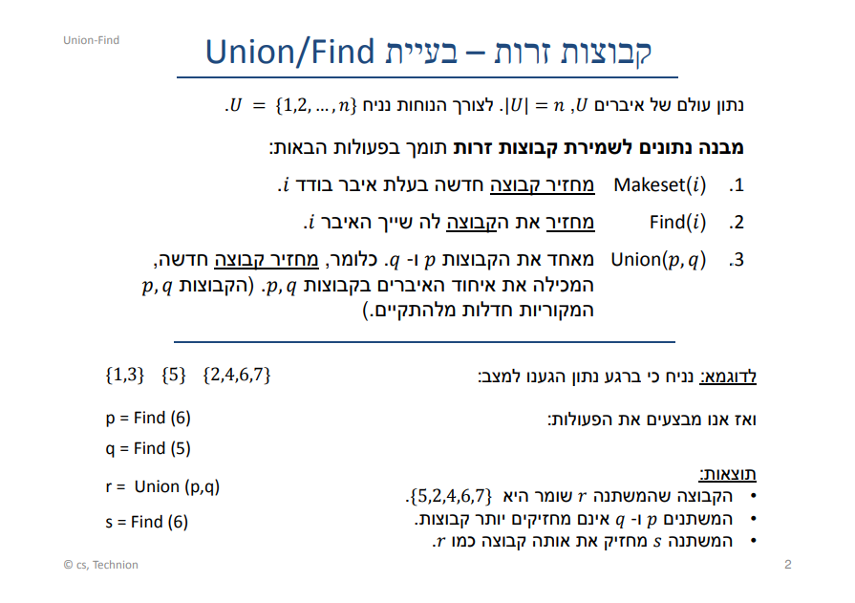

Slide 11
